Slide 1

Sortify
From Sheets-to-Charts 📊
Code Red Hackathon 2025
Presented by: Monish D & Aditya Narayanan

Slide 2

Raw Data To Refined Results
"Small and medium-sized businesses often deal with raw CSV or Excel files that are messy, hard to interpret, and contain missing or inconsistent data — slowing down decision-making."
Many small businesses don't have data analysts and most tools today expect you to code or be tech-savvy. This makes it hard to understand your own data, causing delays and lost insights.

Slide 3



Sortify: Your No-Code Data Analyst
Sortify is a lightweight, no-code tool designed to transform messy data into clear insights. It's built for speed and accessibility.
Clean & Filter
Effortlessly clean and filter raw, messy data from various file types.
Auto-Visualize
Generate instant visualizations like histograms and bar charts for rapid understanding.
Insightful Summaries
View key statistics: count, mean, median, mode, standard deviation, quartile and many more functionalities.

Slide 4

Key Features
One-click upload: Seamlessly import CSV or Excel files.
Missing value analysis: Identify and quantify missing data at a glance.
Automatic type detection: Intelligently classifies columns as numeric or categorical.
Visual summaries: Get immediate graphical insights for every column.

Slide 5
Under the Hood
Python & Streamlit
Core logic and interactive UI built with Python and the rapid development capabilities of Streamlit.
Numpy, Pandas, Matplotlib & Seaborn
Robust data manipulation with Pandas and powerful visualization with Seaborn and Matplotlib.
Simple Logic
Utilizes straightforward algorithms for auto-detection and summary generation. No complex AI/ML involved.
The intuitive sidebar provides clear instructions, guiding users through the data analysis process step-by-step.

Slide 6
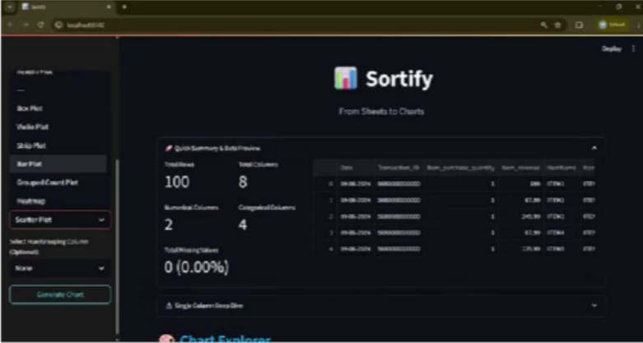
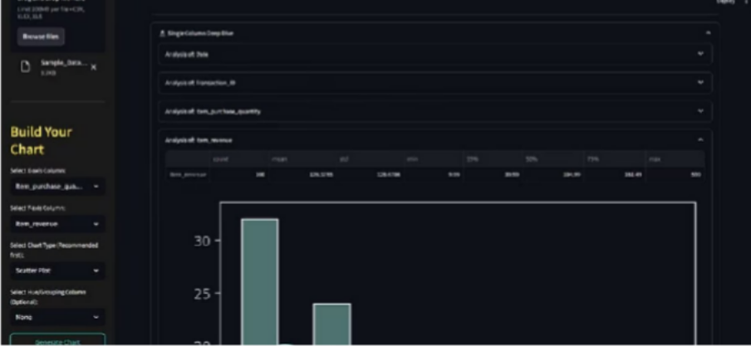
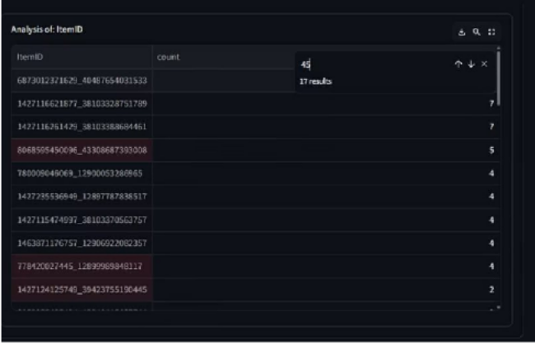
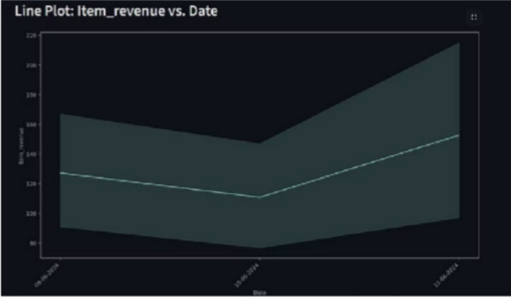
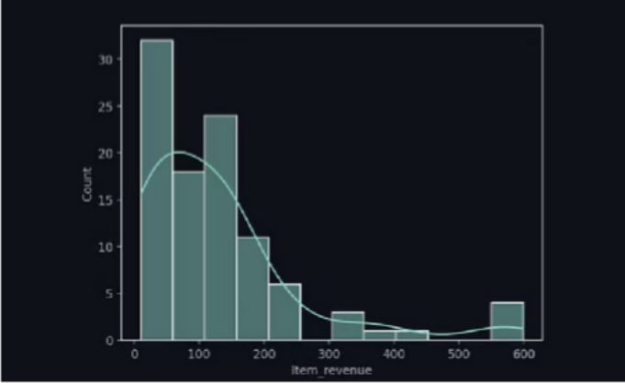
Sortify in Action
These visuals demonstrate the seamless workflow from file upload to insightful data visualization, all within a clean, responsive Streamlit interface.

Slide 7
Impact & Advantages
Efficiency
Fast and easy to use: Drastically reduces the time spent on initial data cleaning and exploration.
Accessibility
Offline capabilities: Runs locally, requiring no internet connection or cloud infrastructure, ensuring data privacy.
Empowerment
Bridging the gap: Empowers both developers for quick sanity checks and non-technical users to independently derive insights.
Foundation
Pre-analysis exploration: Ideal for rapid preliminary analysis before committing to deeper, more complex investigations.

Slide 8




The Road Ahead
Exportable Reports
Generate comprehensive summary reports in CSV or Excel formats for further use.
Column Filtering
Allow users to select specific columns for focused analysis and visualization.
Enhanced Visuals
Integrate more chart types like bar plot, hue-plots, histograms, scatter plots, hexbin, box plots, violin plots, strip plots, heatmaps, line graphs and more for diverse data representations.
Customizability
Enable users to customize their graphs with respect to X and Y axis with hue conditions.

Slide 9



Connect with Sortify
Github Contact Us
Explore and contribute:https://github.com/Monis h-D609/Sortify---From-Sheets-To- Charts
Reach out: monishpersonal609@gmail.com
+91 7676607637
Connect with us on LinkedIn:
adityanarayanan.c@gmail.com
+91 8446593869

Slide 10

Sortify:
From Sheets-to-Graphs.
Thank you!

